Slide 1
Cascading Style Sheets (CSS)

Slide 2
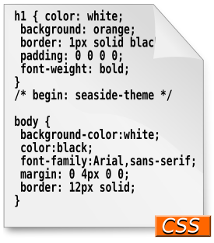
What is CSS?
Cascading Style Sheets (CSS): is a simple mechanism for adding style (e.g. fonts, colors, layouts) to Web documents.
Styles provide powerful control over the presentation of web pages.

Slide 3
Internal Style Sheet
A style sheet consists of a set of rules.
Each rule consists of one or more selectors and a declaration block.
A declaration block consists of a list of declarations in curly braces ({}).
Each declaration consists of a property, a colon (:), a value, then a semi-colon (;).

Slide 4
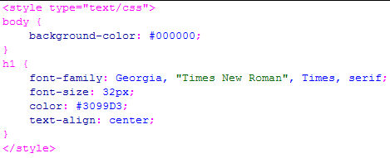
Style Sheet Syntax Explained
selector
property
value
rule

Slide 5
Basic CSS Syntax
CSS Syntax
  selector {property: value;}

Slide 6
Three Different Scopes of CSS
Local
  confined to a single element (tag)
Internal
  affect elements in an entire page
External
  can affect multiple pages
Precedence
  Local > Internal > External
Notes:
The term cascading comes from the effect of the way the different styles are applied when more than one exists.

Slide 7
Local Style Sheet
Example
  <h1 style="color:white; background:orange; font-weight:bold;">Internal Style Sheet Applied to Header 1</h1>
Practice
  add “text-align” property to make it centered
  add “border” property to let it has black, 1px thick, solid border at left, right, top, and bottom
Tip: use “border: <top> <right> <bottom> <left>;” format for 4 sides; use “border-<side>: xx yy zz;” for a particular side, where <side> can be left, right, top or bottom. Can apply to other similar properties.

Slide 8
Internal Style Sheet
How to create?
  Put <style> </style> tag between <head> and </head> tags of your HTML page
  Use type attribute to indicate the style sheet type, usually type=“text/css”
  Specify a default style sheet language for the whole document by
  <meta http-equiv="Content-Style-Type" content="text/css" />
  Put your set of style sheet rules in between <style> and </style> tags

Slide 9
Internal Style Sheet
Practice
  Create same style in the example in the local style sheet section, but using internal style sheet instead.

Slide 10
External Style Sheet
An external style sheet is simply a text-only file that contains only CSS rules.
How to link to external style sheet?
  <link href=“URL of CSS File" rel="stylesheet" type="text/css" />
Practice
  Create a file called “mystyle.css” and do the example in local style sheet, but as external style sheet

Slide 11
Selector Type
Tag
  redefines the look of a specific tag
  E.g. body {background-color: #000000;}
Class
  can apply to any tag
  E.g. .indent{margin-right:5%;margin-left: 5%;}
  In HTML, <p class=“indent”>
Advanced
  IDs, pseudo-class selectors
  E.g. #myId {color: #38608A;}
Notes:
pseudo-classes are used in CSS selectors to allow information external to the HTML source (e.g. the fact that an anchor has been visited or not) to classify elements.

Slide 12
Using Different CSS Selectors
Type Selector
  redefines the look of a specific tag
  A type selector matches every instance of the element type in the document tree
  E.g. body {background-color: #000000;}
Class Selector
  can apply to any tag
  E.g. .indent{margin-right:5%;margin-left: 5%;}
  In HTML, <p class=“indent”>
ID Selector
  E.g. #myId {color: #38608A;}
  In HTML, <h1 id="myId">some text..</h1>
Notes:
pseudo-classes are used in CSS selectors to allow information external to the HTML source (e.g. the fact that an anchor has been visited or not) to classify elements.

Slide 13
Using Different CSS Selectors
Grouping
  When several selectors share the same declarations, they may be grouped into a comma-separated list.
  e.g. h1, h2, h3 {font-family: Georgia;}
Universal selector
  The universal selector, written "*", matches the name of any element type.
  e.g. * {border: 2px;}

Slide 14
Using Different CSS Selectors
Descendant selector (>)
  Sometimes, you want selectors to match an element that is the descendant of another element in the document tree
  (e.g., "Match those EM elements that are contained by an H1 element").
  Descendant selectors express such a relationship in a pattern.
  A descendant selector is made up of two or more selectors separated by whitespace.
  e.g. h1 > em {color: blue;}

Slide 15
Using Different CSS Selectors
When to use which?
  Use “type selector” when you want to apply certain style for all occurrences of a certain tag
  Use “ID selector” if you want to apply the style for only one occurrence of a certain tag
  Use “class selector” if you want to apply the style for many (but not all) occurrences of a certain tag; OR if you want to apply the style for more than one type of tags

Slide 16
Using Different CSS Selectors
When to use which? (cont.)
  Use “Grouping” When several selectors share the same declarations
  Use “Universal selector” if you want all the tags in your web documents have some common style (for example, all tags don’t have any margin)
  Use “Descendant selectors” if you want selectors to match an element that is the descendant of another element

Slide 17
Values - Lenghts
Lengths [a number + unit identifier]
  Unit identifier can be
  em (font size of the relevant font),
  ex (x-height of the relevant font),
  px (pixels),
  in (inches), cm (centimeter), mm,
  pt (points, =1/72 in), pc (picas, 1 pc = 12 pt)
  E.g.
  h1 { margin: 0.5em }, h1 { margin: 1ex },
  p { font-size: 12px }, h2 { line-height: 3cm }, h4 { font-size: 12pt }, h4 { font-size: 1pc }

Slide 18
Values – Percentages & URIs
Percentages [a number + %]
  p { line-height: 120% }
URLs & URIs
  url(“<A URI/URL>”), or
  url(<A URI/URL>)
  li { list-style: url(http://www.cse.jnu.ac.bd/~kabir/image/bullet2.jpg) disc }
  body { background: url("yellow.png") }
  where, “yellow” is relative to the URI of the style sheet.

Slide 19
Values - Colors
Colors
  A color is either a keyword (e.g. white, red), or a numerical RGB specification (e.g. ).
A numerical RGB specification can be:
  An RGB value in hexadecimal notation, which is a ‘#’ immediately followed by a 6 digit or 3 digit hexadecimal number, i.e.
  #rrggbb or #rgb.
  E.g. #ff0000, #f00
  An RGB value in functional notation, i.e.
  rgb(rrr,ggg,bbb), rgb(r%,g%,b%)
  E.g. rgb(255,0,0), rgb(100%,0%,0%)

Slide 20
Positioning Properties
height : <length> | <percentage> | inherit
width : <length> | <percentage> | inherit
left : <length> | <percentage> | auto | inherit
top : <length> | <percentage> | auto | inherit
right : <length> | <percentage> | auto | inherit
bottom : <length> | <percentage> | auto | inherit
position : static | relative | absolute | fixed | inherit
left/top/right/bottom usually used when position is specified as absolute.

Slide 21
Values for position property
Value | Description
static | Default. An element with position: static always has the position the normal flow of the page gives it (a static element ignores any top, bottom, left, or right declarations)
relative | An element with position: relative moves an element relative to its normal position, so "left:20" adds 20 pixels to the element's LEFT position
absolute | An element with position: absolute is positioned at the specified coordinates relative to its containing block. The element's position is specified with the "left", "top", "right", and "bottom" properties
fixed | An element with position: fixed is positioned at the specified coordinates relative to the browser window. The element's position is specified with the "left", "top", "right", and "bottom" properties. The element remains at that position regardless of scrolling. Works in IE7 (strict mode)

Slide 22
Positioning Properties
A floated box is shifted to the left or right until its outer edge touches the containing block edge or the outer edge of another float.
Example
.positionStyle {
height: 400px;
width: 200px;
left: 50px;
top: 50px;
right: 50px;
bottom: 50px;
position:absolute;
float: rigth;
}

Slide 23
Background Properties
background-color: <color> | transparent | inherit
background-image: <uri> | none | inherit
background-repeat: repeat | repeat-x | repeat-y | no-repeat | inherit
background-attachment: scroll | fixed | inherit
background-position: left | center | right | top | bottom | center | fixed | inherit

Slide 24
Background Properties
Practice
body {
background-image: url(http://www.cs.pitt.edu/~mehmud/image/bgd.png);
background-repeat:no-repeat;
color: #FFFFFF;
background-position:center center;
background-color: #666666;
background-attachment: fixed;
}

Slide 25
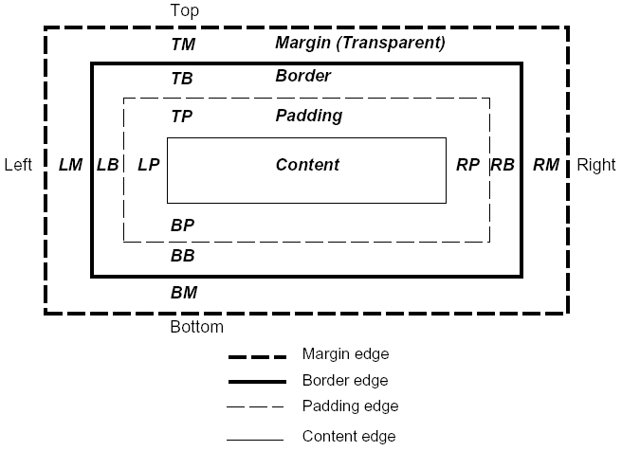
Box Model

Slide 26
Border Properties
border-width: in | px | pt | cm | em
border-style: dotted | dashed | solid | double | groove | ridge | inset | outset | none | hidden
border-color: <color> | transparent

Slide 27
Margin Properties
The CSS margin properties are used to generate space around elements.
The margin properties set the size of the white space OUTSIDE the border.
margin: <length> | <percentage> | auto | inherit
auto - the browser calculates the margin
length - specifies a margin in px, pt, cm, etc.
% - specifies a margin in % of the width of the containing element
inherit - specifies that the margin should be inherited from the parent element

Slide 28
Padding Properties
The CSS padding properties are used to generate space around content.
The padding properties set the size of the white space between the element content and the element border.
padding: <length> | <percentage> | inherit
length - specifies a margin in px, pt, cm, etc.
% - specifies a margin in % of the width of the containing element
inherit - specifies that the margin should be inherited from the parent element

Slide 29
Box Properties
Example:
p{
margin: 50px;
padding: 30px;
float: right;
height: 200px;
width: 400px;
border: 5px solid #006633;
}

Slide 30
Text Properties
font-family : <font name>, | <font name>, …
font-size : <length> | <percentage> | inherit
font-weight : normal | bold | lighter | 100 | 200 ...
  normal = 400, bold = 700, lighter is relative
font-style : normal | italic | oblique | inherit
line-height : normal | <length> | <percentage> | inherit
text-transform : capitalize | uppercase | lowercase | none | inherit
color : <color>
text-indent : <length> | <percentage> | inherit
text-align : left | right | center | justify | inherit

Slide 31
Text Properties Practice
Practice
  Create a paragraph text
  Create internal style for <p> tag as following
  Create a internal style called “textStyle” and apply it to paragraph text and let it look like this
p{
margin: 50px;
padding: 50px;
clear: right;
float: right;
border: 10px solid #0066CC;
}

Slide 32
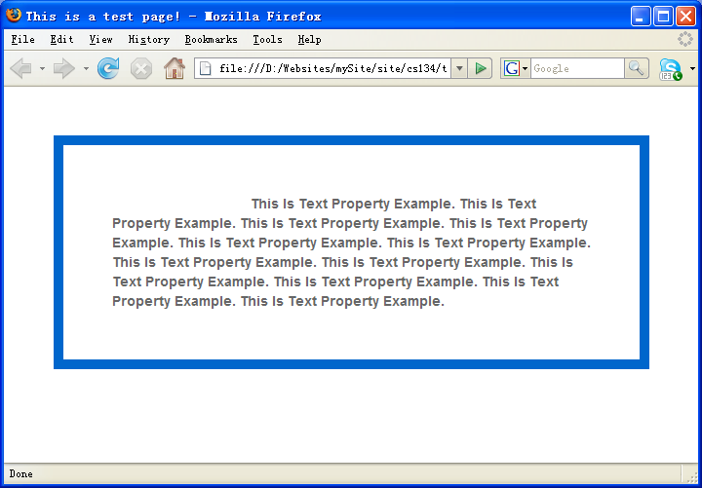
Text Properties Practice
Color is #666666; font-family is Arial, Helvetica, sans-serif; font-indent is 20%;

Slide 33
Link Properties
Links can be styled with any CSS property (e.g. color, font-family, background, etc.)
The four links states are:
a:link - a normal, unvisited link
a:visited - a link the user has visited
a:hover - a link when the user mouses over it
a:active - a link the moment it is clicked

Slide 34
Link Properties
Example:
a:link, a:visited {
background-color: #f44336;
color: white;
padding: 14px 25px;
text-align: center;
text-decoration: none;
display: inline-block;
}
a:hover, a:active {
background-color: red;
}

Slide 35
List Properties
list-style-type: circle | square | upper-roman | lower-alpha … etc.
list-style-position: inside | outside
list-style-image: <url>

Slide 36
Display Properties
The display property specifies if/how an element is displayed.
The default display value for most elements is block or inline.
A block-level element always starts on a new line and takes up the full width available
An inline element does not start on a new line and only takes up as much width as necessary.
display: block | inline | none
visibility: hidden

Slide 37
Float and clear
The float property specifies whether or not an element should float.
The clear property is used to control the behavior of floating elements.
Alternative: inline-block
.div3 {
float: left;
width: 100px;
height: 50px;
margin: 10px;
border: 3px solid #73AD21;
}
.div4 {
border: 1px solid red;
clear: left;
}
.div1 {
float: left;
width: 100px;
height: 50px;
margin: 10px;
border: 3px solid #73AD21;
}
.div2 {
border: 1px solid red;
}

